Slide 1


Chapter 7:
Arrays

Slide 2
7.1
Arrays Hold Multiple Values

Slide 3
Arrays Hold Multiple Values
Array: variable that can store multiple values of the same type
Values are stored in adjacent memory locations
Declared using [] operator:
  int tests[5];

Slide 4
Array - Memory Layout
The definition:
  int tests[5];
allocates the following memory:
first element | second element | third element | fourth element | fifth element

Slide 5
Array Terminology
In the definition int tests[5];
int is the data type of the array elements
tests is the name of the array
5, in [5], is the size declarator. It shows the number of elements in the array.
The size of an array is (number of elements) * (size of each element)

Slide 6
Array Terminology
The size of an array is:
  the total number of bytes allocated for it
  (number of elements) * (number of bytes for each element)
Examples:
  int tests[5] is an array of 20 bytes, assuming 4 bytes for an int
  long double measures[10]is an array of 80 bytes, assuming 8 bytes for a long double

Slide 7
Size Declarators
Named constants are commonly used as size declarators.
const int SIZE = 5;
int tests[SIZE];
This eases program maintenance when the size of the array needs to be changed.

Slide 8
7.2
Accessing Array Elements

Slide 9
Accessing Array Elements
Each element in an array is assigned a unique subscript.
Subscripts start at 0
subscripts:
0 | 1 | 2 | 3 | 4

Slide 10
Accessing Array Elements
The last element’s subscript is n-1 where n is the number of elements in the array.
subscripts:
0 | 1 | 2 | 3 | 4

Slide 11
Accessing Array Elements
Array elements can be used as regular variables:
  tests[0] = 79;
  cout << tests[0];
  cin >> tests[1];
  tests[4] = tests[0] + tests[1];
Arrays must be accessed via individual elements:
  cout << tests; // not legal

Slide 12
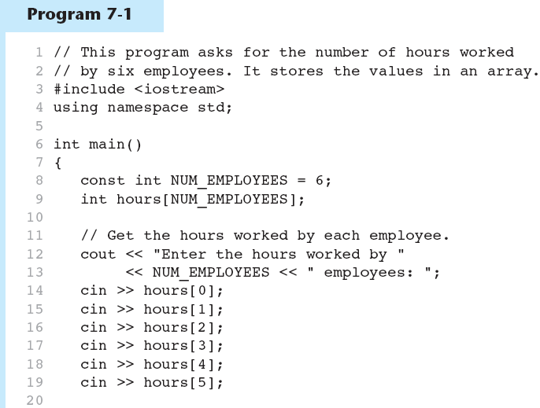
(Program Continues)

Slide 13
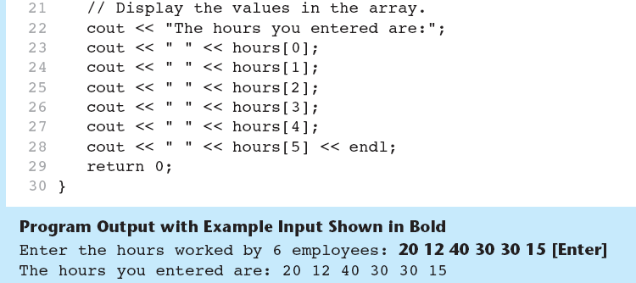
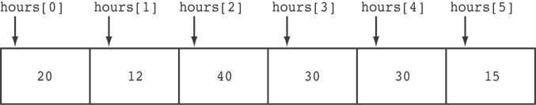
Here are the contents of the hours array, with the values entered by the user in the example output:

Slide 14
Accessing Array Contents
Can access element with a constant or literal subscript:
  cout << tests[3] << endl;
Can use integer expression as subscript:
  int i = 5;
  cout << tests[i] << endl;

Slide 15
Using a Loop to Step Through an Array
Example – The following code defines an array, numbers, and assigns 99 to each element:
const int ARRAY_SIZE = 5;
int numbers[ARRAY_SIZE];
for (int count = 0; count < ARRAY_SIZE; count++)
numbers[count] = 99;

Slide 16
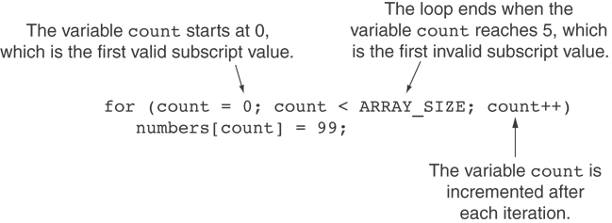
A Closer Look At the Loop

Slide 17
Default Initialization
Global array → all elements initialized to 0 by default
Local array → all elements uninitialized by default

Slide 18
7.3
No Bounds Checking in C++

Slide 19
No Bounds Checking in C++
When you use a value as an array subscript, C++ does not check it to make sure it is a valid subscript.
In other words, you can use subscripts that are beyond the bounds of the array.

Slide 20
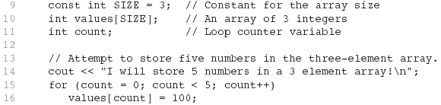
Code From Program 7-5
The following code defines a three-element array, and then writes five values to it!

Slide 21
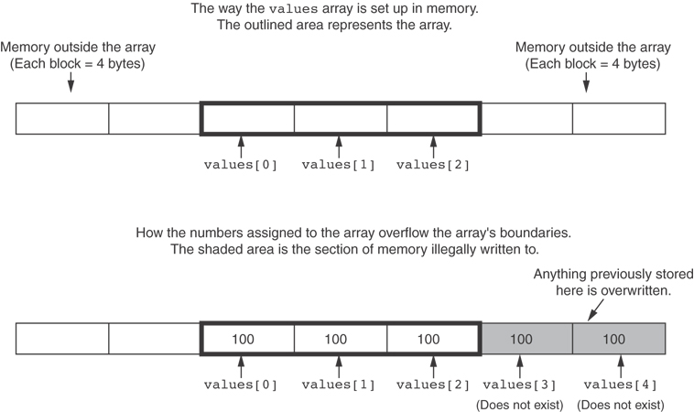
What the Code Does

Slide 22
No Bounds Checking in C++
Be careful not to use invalid subscripts.
Doing so can corrupt other memory locations, crash program, or lock up computer, and cause elusive bugs.

Slide 23
Off-By-One Errors
An off-by-one error happens when you use array subscripts that are off by one.
This can happen when you start subscripts at 1 rather than 0:
// This code has an off-by-one error.
const int SIZE = 100;
int numbers[SIZE];
for (int count = 1; count <= SIZE; count++)
numbers[count] = 0;

Slide 24
7.4
Array Initialization

Slide 25
7.4
Array Initialization

Slide 26
Array Initialization
Arrays can be initialized with an initialization list:
const int SIZE = 5;
int tests[SIZE] = {79,82,91,77,84};
The values are stored in the array in the order in which they appear in the list.
The initialization list cannot exceed the array size.
7-<number>

Slide 27
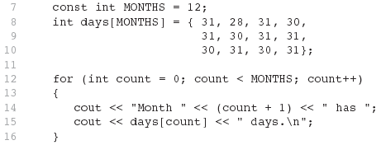
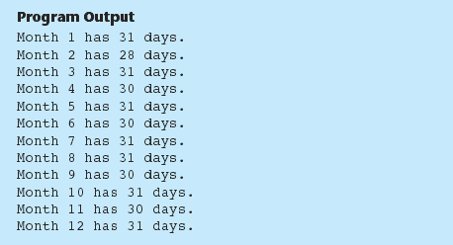
Code From Program 7-6

Slide 28
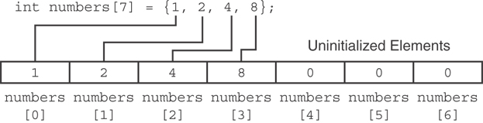
Partial Array Initialization
If array is initialized with fewer initial values than the size declarator, the remaining elements will be set to 0:

Slide 29
Implicit Array Sizing
Can determine array size by the size of the initialization list:
  int quizzes[]={12,17,15,11};
Must use either array size declarator or initialization list at array definition
12 | 17 | 15 | 11

Slide 30
7.5
Processing Array Contents

Slide 31
Processing Array Contents
Array elements can be treated as ordinary variables of the same type as the array
When using ++, -- operators, don’t confuse the element with the subscript:
  tests[i]++; // add 1 to tests[i]
  tests[i++]; // increment i, no
  // effect on tests

Slide 32
Array Assignment
To copy one array to another,
Don’t try to assign one array to the other:
  newTests = tests; // Won't work
Instead, assign element-by-element:
  for (i = 0; i < ARRAY_SIZE; i++)
  newTests[i] = tests[i];

Slide 33
Printing the Contents of an Array
You can display the contents of a character array by sending its name to cout:
char fName[] = "Henry";
  cout << fName << endl;
  But, this ONLY works with character arrays!

Slide 34
Printing the Contents of an Array
For other types of arrays, you must print element-by-element:
  for (i = 0; i < ARRAY_SIZE; i++)
  cout << tests[i] << endl;

Slide 35
Summing and Averaging Array Elements
Use a simple loop to add together array elements:
  int tnum;
  double average, sum = 0;
  for(tnum = 0; tnum < SIZE; tnum++)
  sum += tests[tnum];
Once summed, can compute average:
  average = sum / SIZE;

Slide 36
Finding the Highest Value in an Array
int count;
int highest;
highest = numbers[0];
for (count = 1; count < SIZE; count++)
{
if (numbers[count] > highest)
highest = numbers[count];
}
When this code is finished, the highest variable will contains the highest value in the numbers array.

Slide 37
Finding the Lowest Value in an Array
int count;
int lowest;
lowest = numbers[0];
for (count = 1; count < SIZE; count++)
{
if (numbers[count] < lowest)
lowest = numbers[count];
}
When this code is finished, the lowest variable will contains the lowest value in the numbers array.

Slide 38
Partially-Filled Arrays
If it is unknown how much data an array will be holding:
  Make the array large enough to hold the largest expected number of elements.
  Use a counter variable to keep track of the number of items stored in the array.

Slide 39
Comparing Arrays
To compare two arrays, you must compare element-by-element:
const int SIZE = 5;
int firstArray[SIZE] = { 5, 10, 15, 20, 25 };
int secondArray[SIZE] = { 5, 10, 15, 20, 25 };
bool arraysEqual = true; // Flag variable
int count = 0; // Loop counter variable
// Compare the two arrays.
while (arraysEqual && count < SIZE)
{
if (firstArray[count] != secondArray[count])
arraysEqual = false;
count++;
}
if (arraysEqual)
cout << "The arrays are equal.\n";
else
cout << "The arrays are not equal.\n";

Slide 40
7.6
Using Parallel Arrays

Slide 41
Using Parallel Arrays
Parallel arrays: two or more arrays that contain related data
A subscript is used to relate arrays: elements at same subscript are related
Arrays may be of different types

Slide 42
Parallel Array Example
const int SIZE = 5; // Array size
int id[SIZE]; // student ID
double average[SIZE]; // course average
char grade[SIZE]; // course grade
...
for(int i = 0; i < SIZE; i++)
{
cout << "Student ID: " << id[i]
<< " average: " << average[i]
<< " grade: " << grade[i]
<< endl;
}

Slide 43
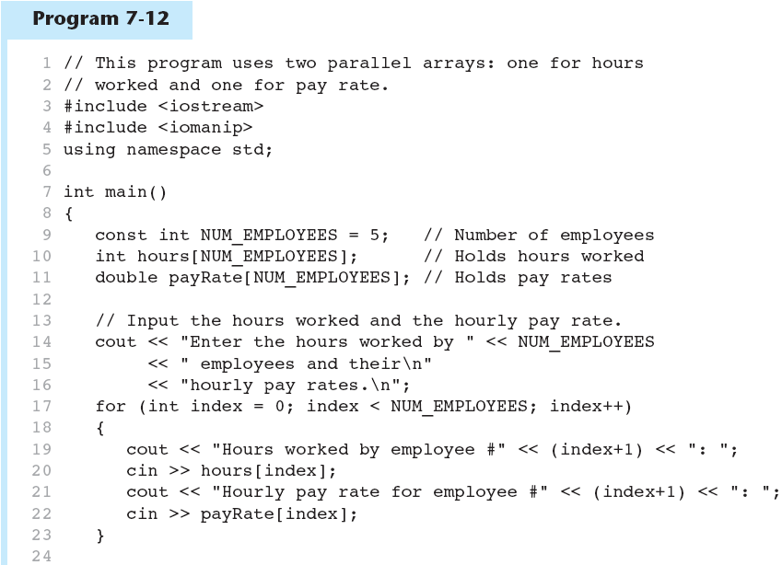
(Program Continues)

Slide 44
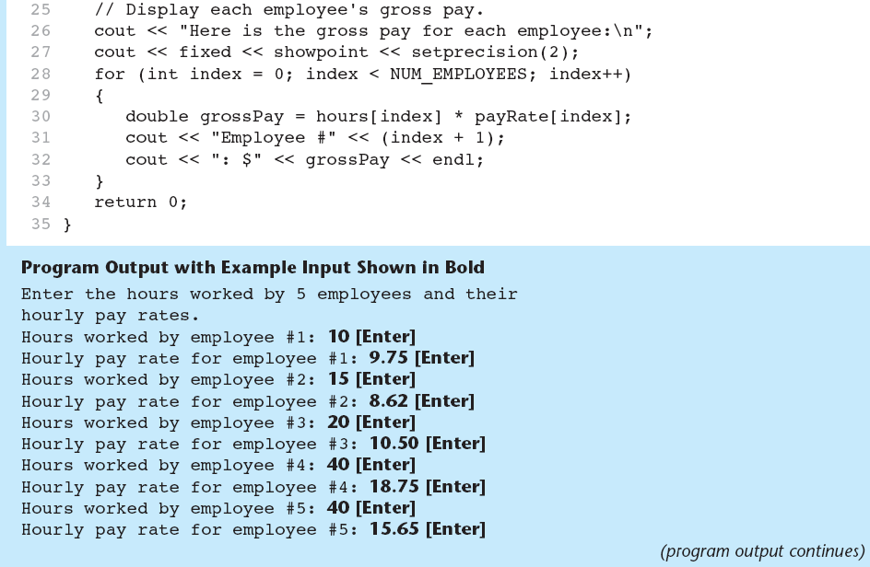
Program 7-12 (Continued)

Slide 45
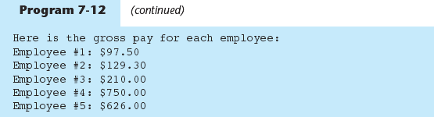
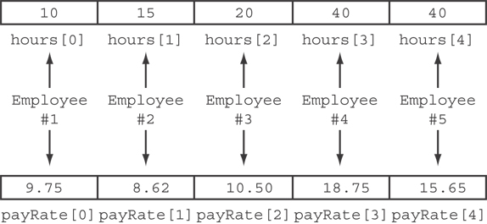
The hours and payRate arrays are related through their subscripts:

Slide 46
7.7
Arrays as Function Arguments

Slide 47
Arrays as Function Arguments
To pass an array to a function, just use the array name:
  showScores(tests);
To define a function that takes an array parameter, use empty [] for array argument:
  void showScores(int []);
  // function prototype
  void showScores(int tests[])
  // function header

Slide 48
Arrays as Function Arguments
When passing an array to a function, it is common to pass array size so that function knows how many elements to process:
  showScores(tests, ARRAY_SIZE);
Array size must also be reflected in prototype, header:
  void showScores(int [], int);
  // function prototype
  void showScores(int tests[], int size)
  // function header
7-<number>

Slide 49
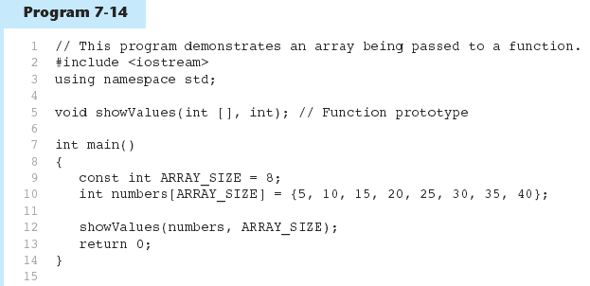
(Program Continues)

Slide 50
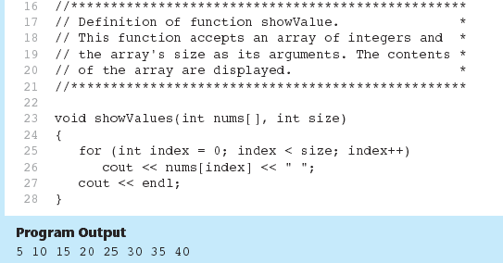
Program 7-14 (Continued)

Slide 51
Modifying Arrays in Functions
Array names in functions are like reference variables – changes made to array in a function are reflected in actual array in calling function
Need to exercise caution that array is not inadvertently changed by a function

Slide 52
7.8
Two-Dimensional Arrays

Slide 53
Two-Dimensional Arrays
Can define one array for multiple sets of data
Like a table in a spreadsheet
Use two size declarators in definition:
  const int ROWS = 4, COLS = 3;
  int exams[ROWS][COLS];
First declarator is number of rows; second is number of columns

Slide 54
Two-Dimensional Array Representation
const int ROWS = 4, COLS = 3; int exams[ROWS][COLS];
Use two subscripts to access element:
  exams[2][2] = 86;
columns
exams[0][0] | exams[0][1] | exams[0][2]
exams[1][0] | exams[1][1] | exams[1][2]
exams[2][0] | exams[2][1] | exams[2][2]
exams[3][0] | exams[3][1] | exams[3][2]
r
o
w
s

Slide 55
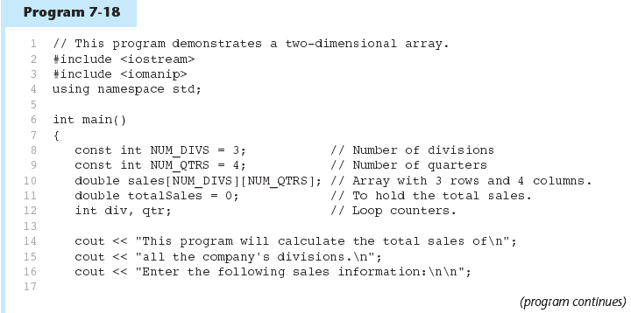

Slide 56
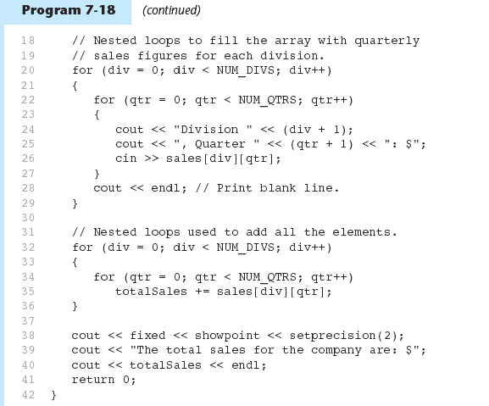

Slide 57
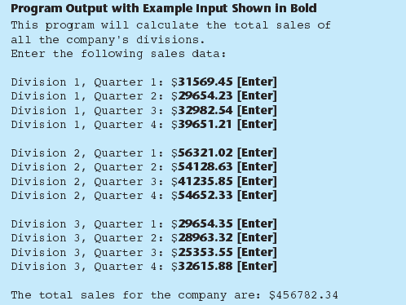
7-<number>

Slide 58
2D Array Initialization
Two-dimensional arrays are initialized row-by-row:
const int ROWS = 2, COLS = 2;
int exams[ROWS][COLS] = { {84, 78},
  {92, 97} };
Can omit inner { }, some initial values in a row – array elements without initial values will be set to 0 or NULL
84 | 78
92 | 97

Slide 59
Two-Dimensional Array as Parameter, Argument
Use array name as argument in function call:
  getExams(exams, 2);
Use empty [] for row, size declarator for column in prototype, header:
const int COLS = 2;
// Prototype
void getExams(int [][COLS], int);
// Header
void getExams(int exams[][COLS], int rows)

Slide 60
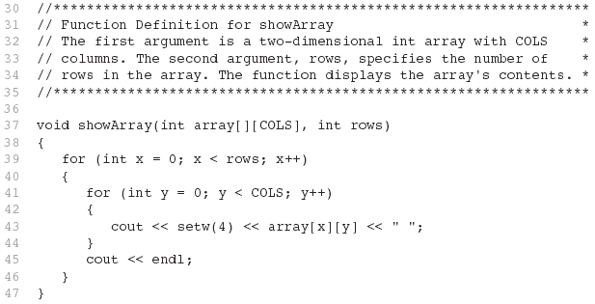
Example – The showArray Function from Program 7-19

Slide 61
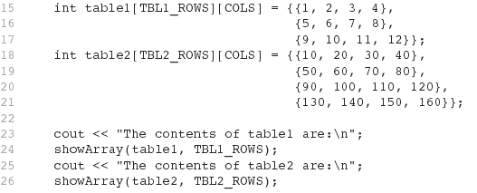
How showArray is Called

Slide 62
Summing All the Elements in a Two-Dimensional Array
Given the following definitions:
const int NUM_ROWS = 5; // Number of rows
const int NUM_COLS = 5; // Number of columns
int total = 0; // Accumulator
int numbers[NUM_ROWS][NUM_COLS] =
{{2, 7, 9, 6, 4},
{6, 1, 8, 9, 4},
{4, 3, 7, 2, 9},
{9, 9, 0, 3, 1},
{6, 2, 7, 4, 1}};

Slide 63
Summing All the Elements in a Two-Dimensional Array
// Sum the array elements.
for (int row = 0; row < NUM_ROWS; row++)
{
for (int col = 0; col < NUM_COLS; col++)
total += numbers[row][col];
}
// Display the sum.
cout << "The total is " << total << endl;

Slide 64
Summing the Rows of a Two-Dimensional Array
Given the following definitions:
const int NUM_STUDENTS = 3;
const int NUM_SCORES = 5;
double total; // Accumulator
double average; // To hold average scores
double scores[NUM_STUDENTS][NUM_SCORES] =
{{88, 97, 79, 86, 94},
{86, 91, 78, 79, 84},
{82, 73, 77, 82, 89}};

Slide 65
Summing the Rows of a Two-Dimensional Array
// Get each student's average score.
for (int row = 0; row < NUM_STUDENTS; row++)
{
// Set the accumulator.
total = 0;
// Sum a row.
for (int col = 0; col < NUM_SCORES; col++)
total += scores[row][col];
// Get the average
average = total / NUM_SCORES;
// Display the average.
cout << "Score average for student "
<< (row + 1) << " is " << average <<endl;
}

Slide 66
Summing the Columns of a Two-Dimensional Array
Given the following definitions:
const int NUM_STUDENTS = 3;
const int NUM_SCORES = 5;
double total; // Accumulator
double average; // To hold average scores
double scores[NUM_STUDENTS][NUM_SCORES] =
{{88, 97, 79, 86, 94},
{86, 91, 78, 79, 84},
{82, 73, 77, 82, 89}};

Slide 67
Summing the Columns of a Two-Dimensional Array
// Get the class average for each score.
for (int col = 0; col < NUM_SCORES; col++)
{
// Reset the accumulator.
total = 0;
// Sum a column
for (int row = 0; row < NUM_STUDENTS; row++)
total += scores[row][col];
// Get the average
average = total / NUM_STUDENTS;
// Display the class average.
cout << "Class average for test " << (col + 1)
<< " is " << average << endl;
}

Slide 68
7.9
Arrays with Three or More Dimensions

Slide 69
Arrays with Three or More
Dimensions
Can define arrays with any number of dimensions:
  short rectSolid[2][3][5];
  double timeGrid[3][4][3][4];
When used as parameter, specify all but 1st dimension in prototype, heading:
  void getRectSolid(short [][3][5]);

Slide 70
7.11
Introduction to the STL vector

Slide 71
Introduction to the STL vector
A data type defined in the Standard Template Library (covered more in Chapter 16)
Can hold values of any type:
  vector<int> scores;
Automatically adds space as more is needed – no need to determine size at definition
Can use [] to access elements

Slide 72
Declaring Vectors
You must #include<vector>
Declare a vector to hold int element:
  vector<int> scores;
Declare a vector with initial size 30:
  vector<int> scores(30);
Declare a vector and initialize all elements to 0:
  vector<int> scores(30, 0);
Declare a vector initialized to size and contents of another vector:
  vector<int> finals(scores);

Slide 73
Adding Elements to a Vector
Use push_back member function to add element to a full array or to an array that had no defined size:
  scores.push_back(75);
Use size member function to determine size of a vector:
  howbig = scores.size();

Slide 74
Removing Vector Elements
Use pop_back member function to remove last element from vector:
  scores.pop_back();
To remove all contents of vector, use clear member function:
  scores.clear();
To determine if vector is empty, use empty member function:
  while (!scores.empty()) ...

Slide 75
Other Useful Member Functions
Member Function | Description | Example
at(elt) | Returns the value of the element at position elt in the vector | cout << vec1.at(i);
capacity() | Returns the maximum number of elements a vector can store without allocating more memory | maxelts = vec1.capacity();
reverse() | Reverse the order of the elements in a vector | vec1.reverse();
resize (elts,val) | Add elements to a vector, optionally initializes them | vec1.resize(5,0);
swap(vec2) | Exchange the contents of two vectors | vec1.swap(vec2);

